Slide 1



Enhancing Mobile Apps to Use Sensor Hubs without Programmer Effort
Haichen Shen, Aruna Balasubramanian, Anthony LaMarca, David Wetherall

Slide 2




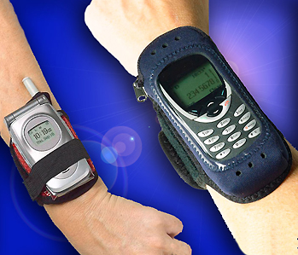


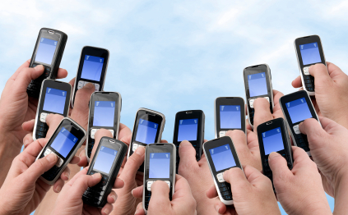
Continuous sensing apps
Step Counting
Fall Detection
Driver Monitor
Theft Detection
Healthcare apps:
Ambulation
Lifestyle monitoring:
BeWell, Acoustic
Participatory sensing:
MobiPerf
Notes:
Sensing apps are designed for different tasks, including step counting/fall detection/ …
Not limited to these tasks, a lot research projects are also using the sensor data to advance the sensing technique
E.g Ambulation: a health monitoring application hat monitors patients with mobility diseases such as Parkinsons

Slide 3
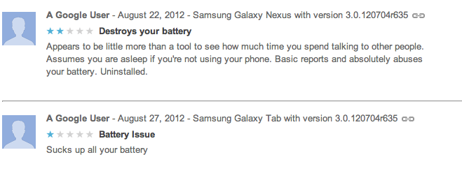
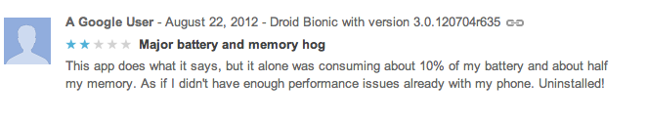
But it drains the battery
Problem: CPU frequently wakes up to process sensor data
Notes:
It is neither the sensors nor the computation that make these applications battery drainers
For example, step counting app wakes 50 times

Slide 4
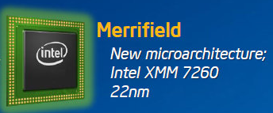
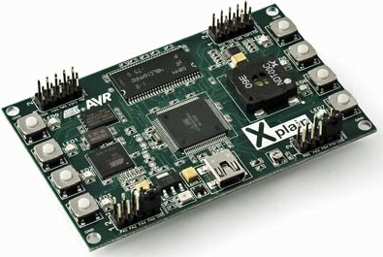


Sensor hub: low power processor
Intel Merrifield
TI’s Tiva
~1.5 mW at 2MHz
Apple M7
Notes:
Because it is an important problem, industry comes up with a solution, which is sensor hub
The sensor hub is a low-power microcontroller which keeps processing contiuously
It collects the sensor data and send back to cpu in a batch, so it lets cpu sleep more often
it operates at a low frequency and consumes less power than cpu, so it can save energy.

Slide 5
Existing approaches make it hard to leverage sensor hub
APIs
Provided by software company, e.g. Apple, Google
Easy to program
Only support a set of pre-defined events
Require programmer effort
Hardware SDK
Provided by hardware manufacturer, e.g. TI TivaWare
Full control of sensor hub
Compatibility
Require programmer effort
Notes:
But it’s not working very well in practice. It is because the existing approaches are not easy enough for developer to leverage
There are two existing approaches: api, sdk. …
Apps developed in one vendor’s environment will not work in another’s and vice versa
Unfortunately, both approaches require programmer effort
As a result, even though sensor hub exists, it is not being used effectively

Slide 6


MobileHub: leverage sensor hub without programmer effort
Optimized app: Same semantics,
but more energy efficient
Analyze app and rewrite binary
MobileHub
System

Slide 7
MobileHub example
Steps:
App
Notification
0
1
Sensor
CPU
Display
Trigger
MobileHub
No change to app semantics
Steps:
0
1
Sensor
CPU
Display
[Idle]
Challenge: How does MobileHub know when the application needs to be triggered?
Trigger
[Active]
CPU idle for longer
Notes:
Because the display is changed at the same time, there’s no change to app semantics

Slide 8
MobileHub system overview
Step 0: Sensor traces
Original
app
Optimized
app
Step 1 Dynamic taint tracking: Track app notifications for a series of sensor inputs
Step 3b Application rewriting: Rewrite app to offload sensing to the sensor hub
MobileHub
System
Taint
log
Sensor parameter
Step 2 Learning: Learn how changes in sensor values result in app notifications
Step 3a Sensor hub program: Implement the classifier in the sensor hub, corresponding to the app
Classifier
model

Slide 9
MobileHub system overview
Step 0: Sensor traces
Original
app
Optimized
app
Step 1 Dynamic taint tracking: Track app notifications for a series of sensor inputs
Step 3b Application rewriting: Rewrite app to offload sensing to the sensor hub
MobileHub
System
Taint
log
Sensor parameter
Step 2 Learning: Learn how changes in sensor values result in app notifications
Step 3a Sensor hub program: Implement the classifier in the sensor hub, corresponding to the app
Classifier
model

Slide 10
Why do we need taint tracking?
Goal: to track when a sensor value leads to an app notification.
Observing the app notifications alone is insufficient.
Use taint tracking to track the sensor data from when it was recorded to when it was used by the application
Notes:
We might observe the alarm, but without knowing semantics, we cannot be certain that the alarm was raised in response to the sensor input.

Slide 11
Taint tracking example
Taint tag
void onSensorChange(sensorEvent){
X = sensorEvent.val;
Y = (X + 1) / 2;
if (Y > THRESHOLD) {
stepCounter++;
display(stepCounter);
}
}
Taint Source
Taint tag
Taint tag
Explicit Information Flow
Implicit Information Flow
Taint tag
Taint Sink

Slide 12
Challenge: implicit flow tracking
Most taint tracking platforms only track explicit flow
Without implicit flow tracking, we could only track 20% of triggers for sensing apps
Use instrumentation to force implicit flow tracking
Built on top of TaintDroid [Enck_OSDI2010]

Slide 13
Instrumentation for implicit flow tracking
void onSensorChange(sensorEvent){
X = sensorEvent.val;
Y = (X + 1) / 2;
tag = getTaintTag(Y);
if (Y > THRESHOLD) {
stepCounter++;
Taint(stepCounter, tag);
display(stepCounter);
}
}
Taint tag
Taint tag
Taint Block
TAINT
CAPTURED
Use static analysis to identify all taint blocks and instrument the app binary automatically.

Slide 14
MobileHub system overview
Step 0: Sensor traces
Original
app
Optimized
app
Step 1 Dynamic taint tracking: Track app notifications for a series of sensor inputs
Step 3b Application rewriting: Rewrite app to offload sensing to the sensor hub
MobileHub
System
Taint
log
Sensor parameter
Step 2 Learning: Learn how changes in sensor values result in app notifications
Step 3a Sensor hub program: Implement the classifier in the sensor hub, corresponding to the app
Classifier
model

Slide 15



Learning a buffer policy
Hard to use a classifier to model the app logic
Simply learn the statistical properties and distinguish between idle and active periods
Label
Idle
Active
Trigger
Time

Slide 16
Goal: find a proper buffer size
Predict active and idle periods
Reduce the number of notification delays
Less energy saving
More energy saving but notification delay
Buffer
Buffer
Trigger
Buffer
Time
Notes:
MobileHub buffers as many sensor data as possible when it is safe; otherwise it will notify the application

Slide 17
MobileHub system overview
Step 0: Sensor traces
Original
app
Optimized
app
Step 1 Dynamic taint tracking: Track app notifications for a series of sensor inputs
Step 3b Application rewriting: Rewrite app to offload sensing to the sensor hub
MobileHub
System
Taint
log
Sensor parameter
Step 2 Learning: Learn how changes in sensor values result in app notifications
Step 3a Sensor hub program: Implement the classifier in the sensor hub, corresponding to the app
Classifier
model

Slide 18
Implementation
Implemented in Android
Taint tracking system
Interface with sensor hub
App binary rewriter
Prototype
Implemented classifier on sensor hub

Slide 19
Evaluation
Does the prototype work?
Does MobileHub improve power consumption on real traces?
Does MobileHub work for a large number of apps?

Slide 20
Prototype measurement
Notes:
We downloaded one pedometer app from Google Play store, and run it on our prototype
5 minutes: 30 seconds stationary and manually move it for 30 seconds in turn
22J vs 84J (almost ¼)
Sensor hub power consumpt: 0.55J, 2.5%

Slide 21
Evaluation using real sensor traces
Trace collection from 21 participants
10 traces for sleeping, driving, and daily life
5 traces for other activities
Downloaded 20 apps from Google Play

Slide 22
Name | Google Play Store ID | Task | Sensor
nWalk | pl.rork.nWalk | Step counting | Accelerometer
pedometer | bagi.levente.pedometer | Step counting | Accelerometer
stepcounter | Stepcounter.Step | Step counting | Accelerometer
appsone | net.appsone.android.pedometer | Step counting | Accelerometer
virtic | jp.virtic.apps.WidgetManpok | Step counting | Accelerometer
walking | cha.health.walking | Step counting | Accelerometer
lodecode | com.lodecode.metaldetector | Metal detector | Magnetometer
imkurt | com.imkurt.metaldetector | Metal detector | Magnetometer
tdt | com.tdt.magneticfielddetector | Metal detector | Magnetometer
multunus | com.multunus.falldetector | Fall detector | Accelerometer
iter | com.iter.falldetector | Fall detector | Accelerometer
t3lab | it.t3lab.fallDetector | Fall detector | Accelerometer
fall | com.fall | Fall detector | Accelerometer
jietusoft | com.jietusoft.earthquake | Earthquake detector | Accelerometer
vibration | ycl.vibrationsensor | Earthquake detector | Orientation
posvic | cz.posvic.fitnessbar.sleeptrack | Sleep monitoring | Gyroscope
myway | myway.project.sleepmanagement | Sleep monitoring | Accelerometer
driving | jp.co.noito.Accelerometer | Driver monitoring | Accelerometer
motion | com.app.accelerometer | Motion detector | Accelerometer
thefthead | com.thefthead.appfinalsettings | Theft detector | Accelerometer

Slide 23
Trace evaluation methodology
Run each app on the phone receiving sensor values from a trace file
Trace file embeds the buffering policy
Power Accounting:
Measure the power consumption of phone
Deduct the standby power consumption

Slide 24
Energy improvement
Notes:
The results show that Mobilehub can improve the power consumption by a median of 74%
Taking out the metal apps, mobilehub improves power consumption by 70% in average

Slide 25
Notification delay
Notification is delayed by at least 0.5s
App | Task | #Delay/#Notifications | Max delay (s)
nWalk | Step Counting | 1/3914 | 1.86
imkurt | Fall Detection | 2/142 | 0.98
posvic | Sleep Monitor | 1/36 | 0.64
thefthead | Anti-theft | 6/65 | 2.80
Notes:
Across all apps, 1.5% notifications are delayed. Here I only show 4 of them here for illustration
Max delay is less than 1 sec in 80% of cases

Slide 26
Conclusion
Design and implement MobileHub that rewrites application to leverage sensor hub without programmer effort
Experiment with 20 sensing apps, and reduce power consumption by 74% in median
MobileHub delays 1.5% app notifications across all apps on average

Slide 27
Thank you!
haichen@cs.washington.edu

Slide 28
Sensor Hub Service
Sensor Hub
Sensor Hub Service
App
App
Comm. Manager
Sensor Listener
Sensor Listener
Sensor Distributor
Hub Binder
Hub Binder
Android Binder

Slide 29
Dynamic vs static buffer
Notes:
Buffer size of 10 only reduce power consumptions by 24%
As a comparison MobileHub can reduce power consumption by 68%

